Slide 1
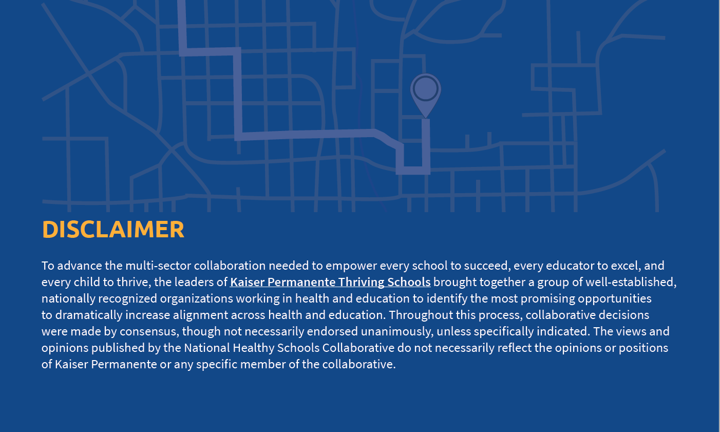

Slide 2

Who We Are
The Roadmap was developed by National Healthy Schools Collaborative a collective impact group of well-established, nationally recognized organizations working in health and education brought together by the Kaiser Permanente Thriving Schools.
Our Mission
To identify bold, ambitious, action-oriented opportunities that have the potential to dramatically increase the number of healthy schools over the next decade.
Our Vision
To coordinate and accelerate multi-sector collaboration needed to empower every school to succeed, every educator to excel, and every child to thrive.

Slide 3

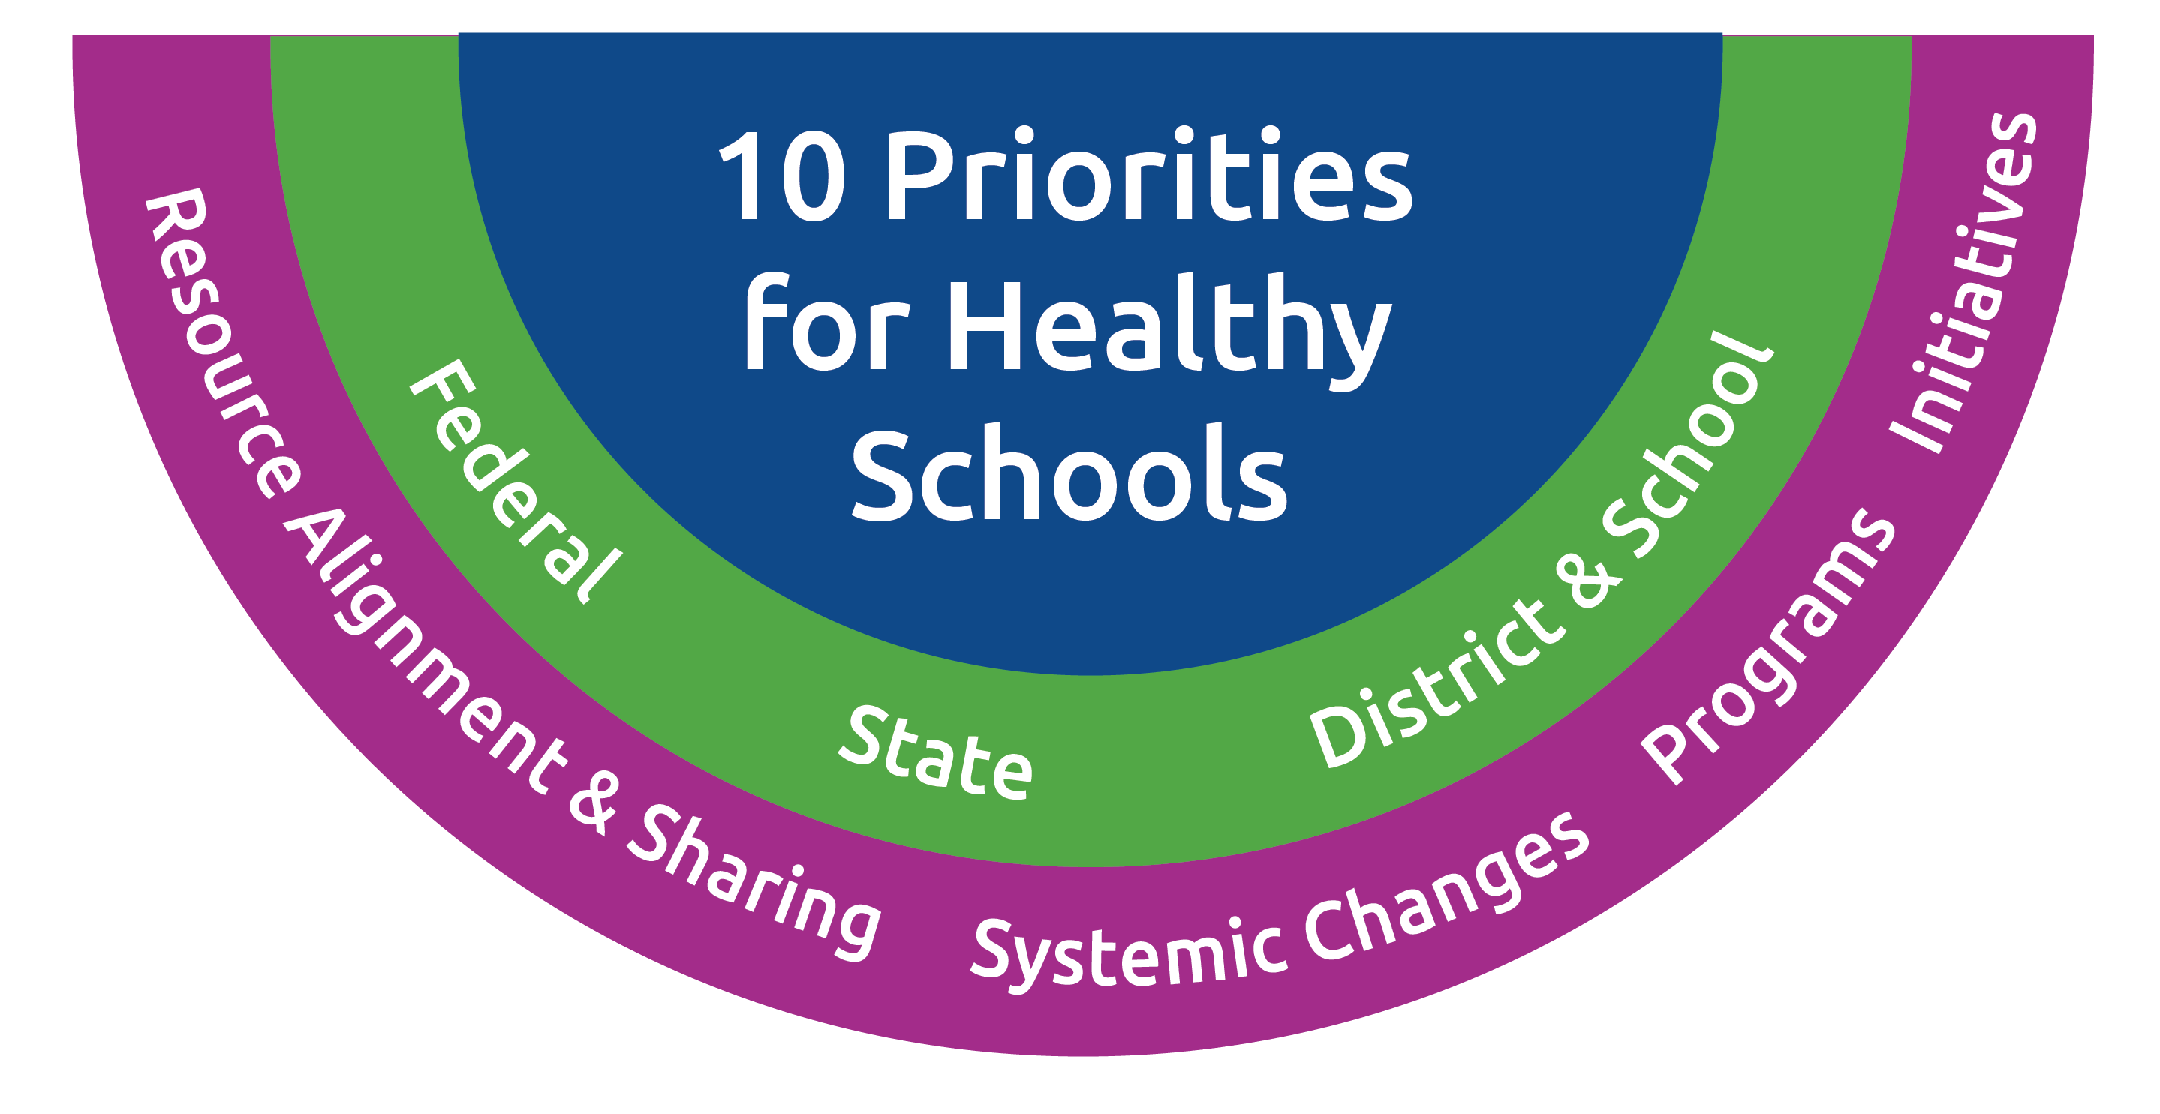
The National Healthy Schools Collaborative identified the top ten priorities for the next ten years to support healthy schools.
The Healthy Schools Roadmap is designed for stakeholders to take action in many ways at every level: federal, state, district, and school.
Each priority area includes opportunities for discussion and action to make schools a healthy place to work, learn, and play.

Slide 4


























The roadmap continues to build momentum among influential organizations
NHSC Members
Growing Body of Collaborating Organizations
4

Slide 5
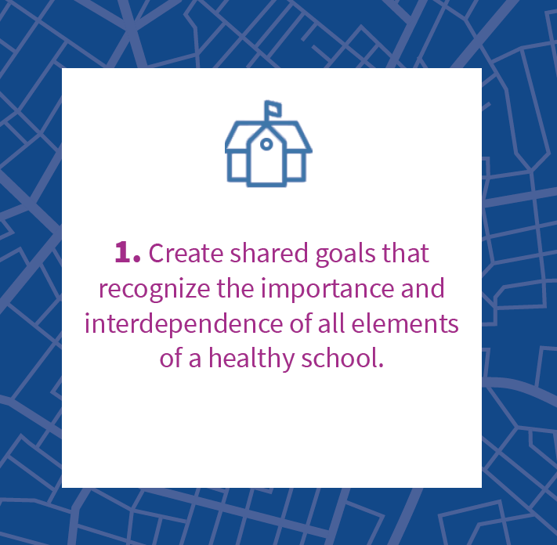

Priority 1
Opportunity Examples (See website for more)
  Federal
  Expand formula grant funding specific to supporting healthy schools, currently funded under the Student Support and Academic Enrichment Grants program (Title IV, Part A) of the Every Student Succeeds Act.
  State
  Provide guidance on how to integrate education data (e.g., chronic absenteeism, school climate, preschool enrollment, workforce program participation, and school readiness assessments) into state health data systems (e.g., birth records and vital statistics, immunizations, Medicaid, and Children’s Health Insurance Program, social services data, and accountability systems).
  District and School
  Create a new position or designate responsibility at the district level for coordinating and monitoring the multi-office management of healthy schools’ policies and funding streams across the district.
Case Study
In Virginia, Fairfax County Public Schools (FCPS) established a School Health Advisory Committee (SHAC) charged with providing recommendations on student health and healthy schools to the school board. Established into law by Virginia Code §22.1-275.1, “the advisory board [assists] with the development of health policy in the school division and the evaluation of the status of school health, health education, the school environment, and health services.” For the 2021-2022 year, the FCPS SHAC is focused on promoting mental health for staff, students, and caregivers. The FCPS SHAC is publicizing and sharing best practices through webinars and podcasts, with the goal of engaging the FCPS community on health and wellbeing issues.

Slide 6
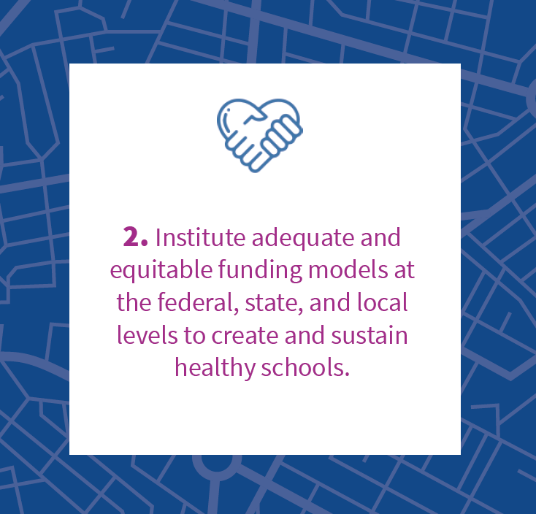

Priority 2
Opportunity Examples (See website for more)
  Federal
  Fully fund school meals (i.e. universal free meals).
  State
  Provide funding to districts for nurses, school psychologists, school counselors, physical educators, occupational health and safety staff, and social workers.
  District and School
  Direct funding towards research-based programs and activities that support sustainable healthy schools, including sufficient staffing.
Case Study
In Georgia, Atlanta Public Schools (APS) is using a mix of funds provided through the Atlanta Public Schools general fund and federal pandemic relief bills to expand their comprehensive health services offerings through their public schools. Over the last two years, the APS Health Services Program has grown from a staff of one to ten and includes a full time epidemiologist, registered nurses, school health coordinator, and COVID-19 case investigators. By working with school nurses at the individual schools, the program is able to deliver a coordinated, team approach that addresses a number of individual and public health issues that can affect learning. Although much of the immediate focus was on pandemic related issues, the health services offerings have expanded to address a wide range of student health needs.

Slide 7
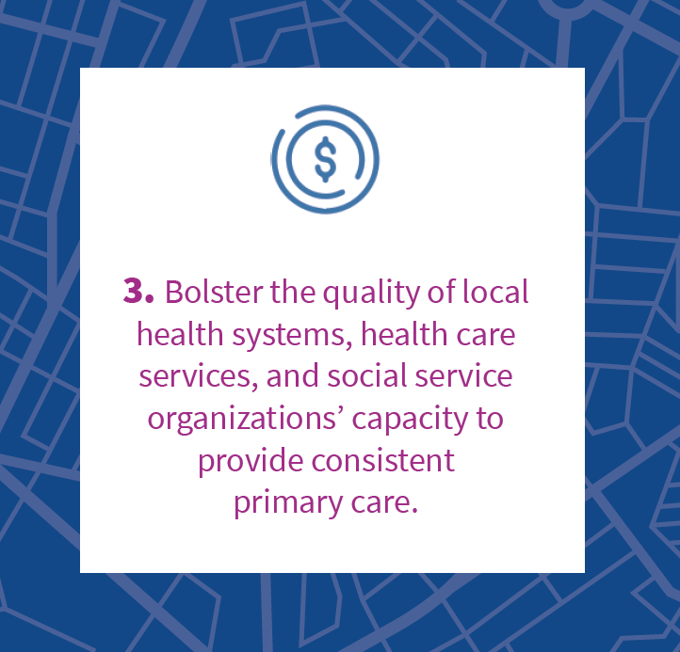

Priority 3
Opportunity Examples (See website for more)
  Federal
  Provide guidance for states and districts to prioritize the continuity of service in partnership with health organizations within Title I and other categorical federal funding streams.
  State
  Incentivize districts and schools to include age-appropriate barriers to learning (e.g., asthma, vision, hearing, dental health, mental and social-emotional wellness, environmental exposure) in annual screenings, either onsite or in collaboration with children’s primary care providers..
  District and School
  Create data-sharing partnerships and guidance on Memorandums of Understanding with community-based primary care providers, referring providers, and school nurses to provide secure electronic access to select portions of their patient’s medical records (e.g., NemoursLink).
Case Study
In Washington, D.C. local public schools are engaged in a telehealth program in partnership with Children’s National Hospital. Students who visit a school nurse are connected through secure video-conferencing technology to a board-certified physician who can manage both acute and chronic conditions, including conditions that can significantly impact child learning such as diabetes or asthma. Additionally, physicians can issue anticipatory health guidance, provide health education and screening, and lead family meetings where necessary. Through the program, children are able to receive quicker access to care, diagnosis, and management thereby leading to faster recovery without the need to wait for services at a hospital or urgent care center.

Slide 8
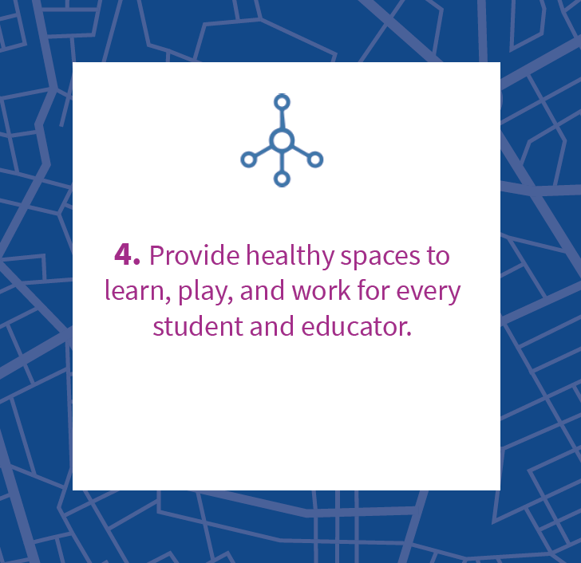

Priority 4
Opportunity Examples (See website for more)
  Federal
  Ensure schools have the updated infrastructure and equipment needed to provide physical activity and nutritious meals to students.
  State
  Conduct annual surveys of state-wide school infrastructure conditions and make them publicly available along with funding to support infrastructure improvements.
  District and School
  Work with educators, administrators, and their unions to develop and implement healthy school training programs, and incorporate, as appropriate, existing approaches to training from OSHA, NIOSH, NIEHS, and others.
Case Study
In Minnesota, The Department of Public Health published an evidence driven Ventilation Guidance for Schools based on recommendations developed by The American Society of Heating, Refrigerating, and Air Conditioning Engineers (ASHRAE) and The Harvard School of Public Health Schools for Health program. The Harvard program includes a five-step strategy to ventilation efficacy in schools which is important not only for mitigating the risk posed by COVID-19, but also for addressing the risk posed by other respiratory pathogens and irritants. Implementing a program like this can help to create a safe working and learning environment for all students and school staff.

Slide 9
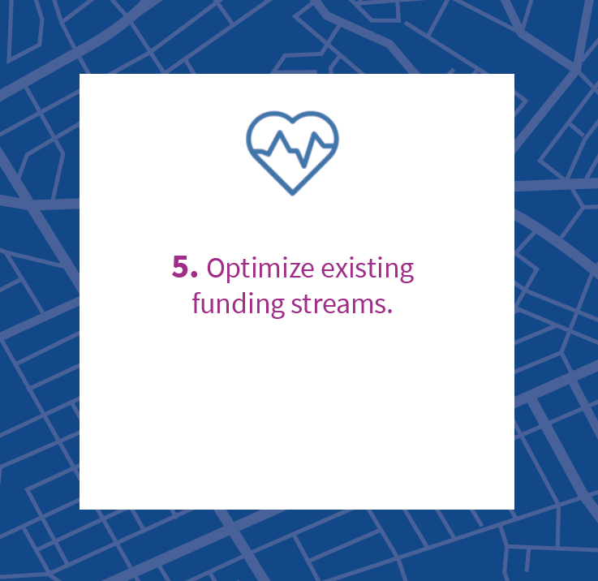

Priority 5
Opportunity Examples (See website for more)
  Federal
  Ensure schools have the updated infrastructure and equipment needed to provide physical activity and nutritious meals to students.
  State
  Expand school Medicaid programs to allow school districts to bill Medicaid for all Early and Periodic Screening, Diagnostic, and Treatment services.
  District and School
  Collaborate with local government agencies to align funding (e.g., agencies overseeing public health, water, parks, and transportation).
Case Study
Michigan submitted a state plan amendment (SPA) in response to a 2014 Centers for Medicare and Medicaid Services (CMS) letter reversing the longstanding “free care rule” that had limited Medicaid reimbursement for services only included in a Medicaid-enrolled student’s Individualized Education Program. The SPA submitted was approved by CMS in 2019 which allowed Michigan to seek reimbursement for services to all Medicaid-enrolled students, not only those with IEPs and further expanded the range of providers who could bill for services provided. The program, known as Caring for Students (C4S) has successfully expanded access to a range of behavioral health and nursing services that were previously inaccessible to a large number of students.

Slide 10
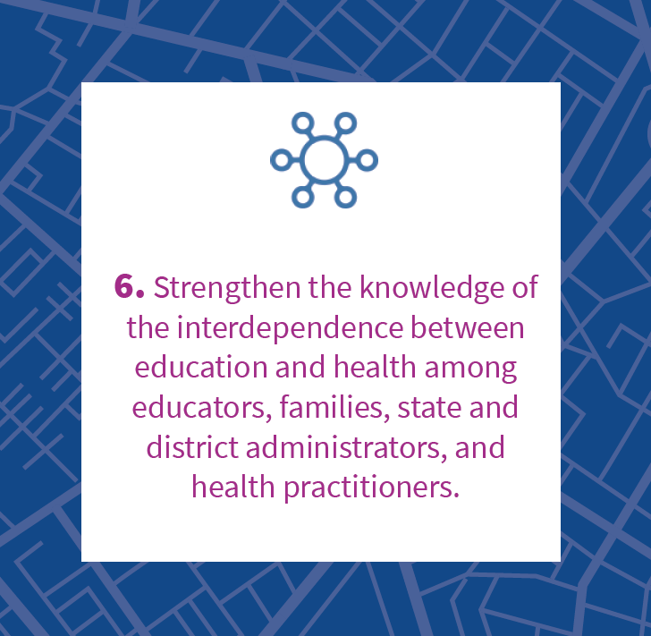
Priority 6
Opportunity Examples (See website for more)
  Federal
  Create a national public awareness campaign focused on the bidirectional influence of health and learning outcomes.
  State
  Develop guidance, training, and technical support to districts on how to leverage funding streams in support of whole child health.
  District and School
  Work with educators, administrators, and their unions to develop and provide comprehensive professional learning opportunities focused on the interdependence of education and learning and focused on alignment with WSCC model categories.
Case Study
In Massachusetts, the Department of Elementary and Secondary Education (DESE) launched a public awareness campaign on COVID-19 focused on how parents, teachers, and students can work together to keep each other healthy and safe. Utilizing an archived and open-source website to communicate with the school community, DESE has published guidance on a wide-range of topics including classroom education, transportation, vaccine information, and other health education issues to develop improved health literacy among stakeholders. DESE regularly updates the platform with policies and guidance to promote information sharing and foster dialogue between school and public health officials, teachers, parents, and students. By keeping all stakeholders informed and working from a common basis of understanding, DESE is able to build a sense of collective responsibility over school health.

Slide 11


Priority 7
Opportunity Examples (See website for more)
  Federal
  Build a healthy schools database utilizing existing data from the CDC, as well as data collected by other federal agencies (e.g., student poverty data collected by USDA, OSHA; state OSH agency data on workplace injuries; and CDC Youth Risk Behavior Surveillance System data) that can be shared, viewed, and studied by researchers, policymakers, and advocates.
  State
  Explore data sharing agreements, while protecting student privacy, that allow healthy schools staff to and health care systems to seamlessly work together.
  District and School
  Coordinate with Student Health Advisory Committees and representatives of the community to determine what student-level data is most important to the community (the WSCC model categories may be a good starting point), what data is currently measured, and what the constraints are to accessing data that is currently unavailable. .
Case Study
The Cincinnati Department of Public Health, Federally Qualified Health Centers, Cincinnati Children’s Hospital, and the Health Foundation of Greater Cincinnati partnered to found Growing Well, an independent nonprofit organization that connects students and families with school-based health services. While most health services provided through Growing Well supported school-based health centers (SBHC) are kept separate from academic data, school nurses and health aides who provide services through these SBHCs, have access to PowerSchool where information about health issues can be linked to academic data at the individual level. The value of this linked data has included comparisons of health outcomes by schools to target needs and identify resources, develop immunization compliance records, and identify incomplete student health records for targeted follow up.

Slide 12
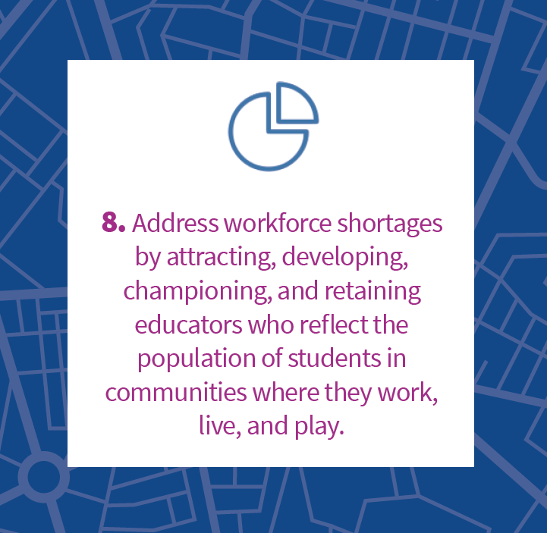

Priority 8
Opportunity Examples (See website for more)
  Federal
  Assist educators with accessing federal student loan forgiveness programs.
  State
  Coordinate with districts and unions to gather data on shortages. Ensure that data capture racial and socioeconomic disparities so policies and programs can effectively address inequities.
  District and School
  Offer high-quality professional learning opportunities and training to educators and healthy schools personnel focused on the whole child, and that address self-care, secondary traumatic stress, compassion fatigue, and burnout prevention.
Case Study
In North Carolina, Governor Roy Cooper issued Executive Order 113 which established the, “Developing a Representative and Inclusive Vision for Education” (DRIVE) Task Force comprised of a diverse and representative group of stakeholders whose goal is to achieve greater equity and inclusion in the education field. The Task Force is charged with submitting a report that will assess “the state’s progress in increasing educator diversity in K-12 public schools, identify short, mid-range, and long-term strategies to increase educator diversity, identify stakeholders, assets, and sources of funding that can be leveraged to recruit, retain, develop, and support more educators of color, propose metrics and standards by which the Governor can evaluate the state’s success in achieving its goals under the Plan, improve recruitment, retention, development, and support of educators of color, and identify priorities for increasing educator diversity in the state.”

Slide 13
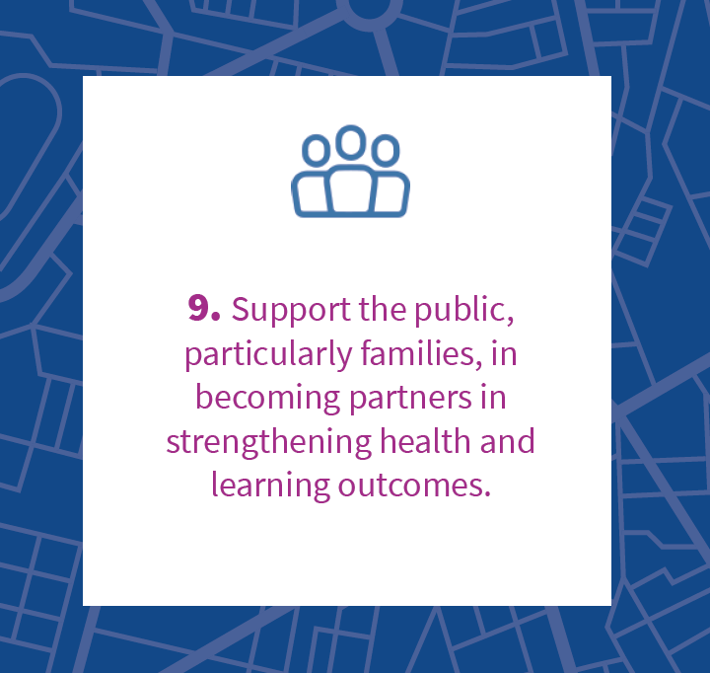

Priority 9
Opportunity Examples (See website for more)
  Federal
  Release guidance on evidence-based best practices for meaningfully engaging families of different backgrounds and circumstances in school activities that address healthy school goals and priorities..
  State
  Create a cross-agency group to coordinate family engagement (e.g., state departments of education, health, children and families, justice, environment, and occupational safety and health).
  District and School
  Prioritize inclusion of student voice and build the capacity of students to be actively engaged in school decision-making around health and learning.
Case Study
In New Mexico, the Albuquerque Family Engagement Collaborative is the resulting embodiment of Albuquerque Public Schools (APS) Board of Education’s goal to, “meaningfully engage families and enhance partnerships with the community to maximize student achievement.” The Collaborative, “is composed of multiple departments and a representative from the New Mexico PTA [that] meets regularly, working together to design and implement programs and projects to help meet the district goals for family engagement.” Through a process that includes sharing what each department is doing for family engagement, determining ways to to work more collaboratively on family engagement, determining how to move the “dial” for more positive family engagement in APS, and identifying how family engagement activities are linked to learning, the Collaborative is actively linking the greater education ecosystem to student health and learning outcomes.

Slide 14
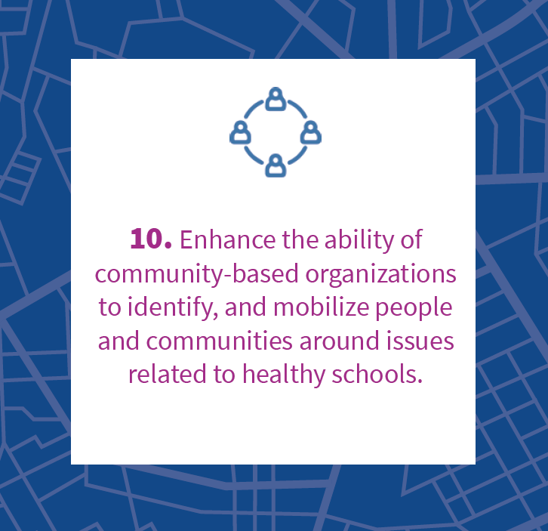

Priority 10
Opportunity Examples (See website for more)
  Federal
  Create a Healthy Schools Award (similar to green schools and blue ribbon) that would recognize districts across the country that have formed community-based partnerships that are leading to positive health and learning outcomes, including those working on school health, children’s health, and occupational safety and health
  State
  Broadcast funding opportunities and share how to best leverage funding to improve health and education outcomes.
  District and School
  Convene community providers regularly to review student-related health and learning outcomes, share resources, and build relationships.
Case Study
In Rhode Island, the Rhode Island Healthy Schools Coalition addresses childhood obesity through a model focused on community partners. The coalition also provides no-fee guidance and program services to school communities focused on overall school wellbeing enhancements. With a mission to make, “all RI schools healthy places for children to learn, grow, and thrive,” the organization leverages the resources of its private and public sector partners to, “develop and implement strong, comprehensive wellness policies.” The organization operates at the intersection of health and education to provide technical assistance for policy and practices, provide resources and tools, and deliver programs that emphasize a healthy whole child vision within all schools.

Slide 15





Take Action
If you are a school or district leader
Take the Thriving Schools Integrated Assessment
The Thriving Schools Integrated Assessment is an evidence-based self-assessment tool that supports districts and schools in identifying strengths and opportunities for improving key elements of the Healthy Schools Ten Year Roadmap.
If you are an organization focused on health or education
Stay Updated
Sign up for the Healthy Schools Roadmap mailing list to learn about opportunities to get involved.
Advocate for Healthy Schools
  Call your elected officials
  Email your elected officials
  Join a town hall meeting
  Contact your child’s district or school leaders
  Show support on social media
If you are an interested community member

